Slide 1

Data Structures
Lecture: Merge Sort
By
Nitish Kumar
Asst. Professor
Lovely Professional University, Punjab

Slide 2
Divide and Conquer
Recursive in structure
  Divide the problem into sub-problems that are similar to the original but smaller in size
  Conquer the sub-problems by solving them recursively. If they are small enough, just solve them in a straightforward manner.
  Combine the solutions to create a solution to the original problem

Slide 3
An Example: Merge Sort
Sorting Problem: Sort a sequence of n elements into non-decreasing order.
Divide: Divide the n-element sequence to be sorted into two subsequences of n/2 elements each
Conquer: Sort the two subsequences recursively using merge sort.
Combine: Merge the two sorted subsequences to produce the sorted answer.

Slide 4
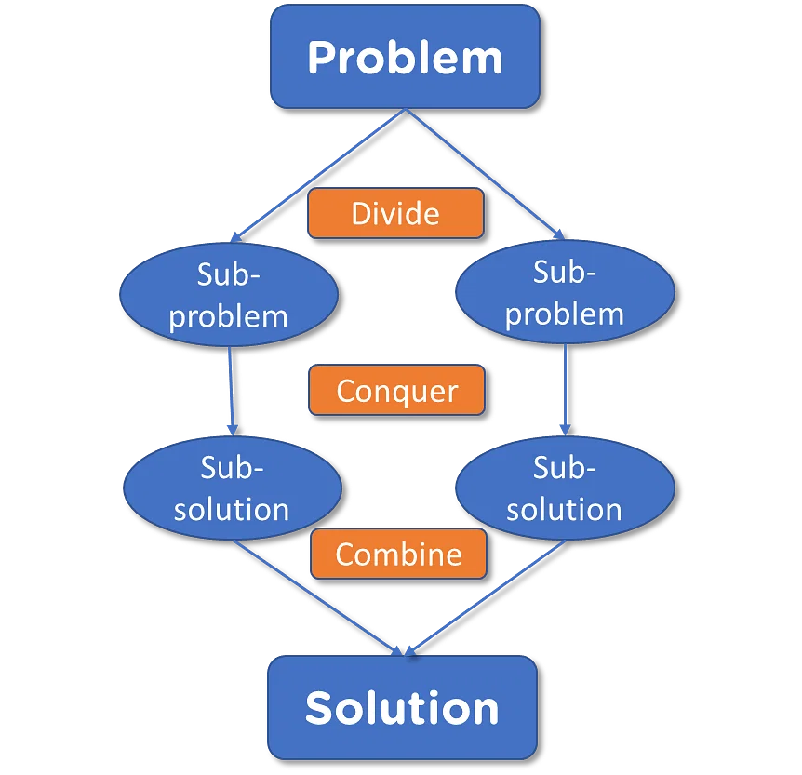

Slide 5
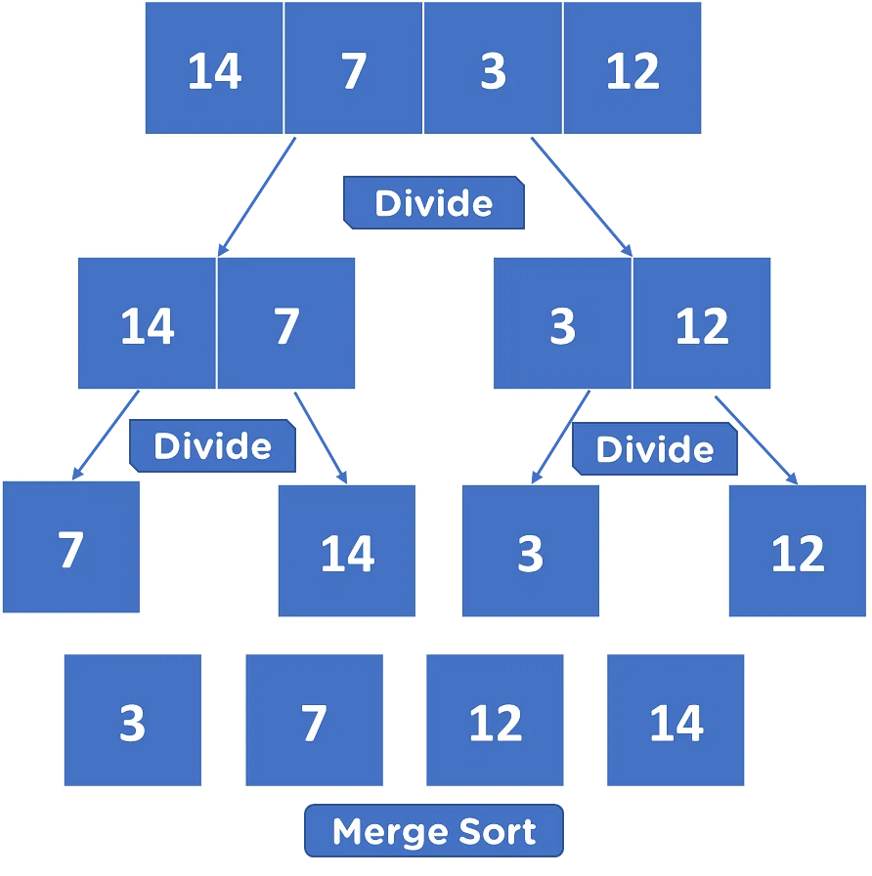

Slide 6
Merge Sort – Example
18
26
32
6
43
15
9
1
22
26
19
55
37
43
99
2
18
26
32
6
43
15
9
1
22
26
19
55
37
43
99
2
18
26
32
6
43
15
9
1
22
26
19
55
37
43
99
2
18
26
32
6
43
15
9
1
22
26
19
55
37
43
99
2
18
26
32
6
43
15
9
1
22
26
19
55
37
43
99
2

Slide 7
Merge Sort – Example
Original Sequence
Sorted Sequence
18
26
32
6
43
15
9
1
18
26
32
6
43
15
9
1
1
6
9
15
18
26
32
43
18
26
32
6
43
15
9
1
18
26
32
6
43
15
9
1
6
26
32
6
18
26
32
18
1
9
15
43
1
9
15
43
18
26
43
15
9
1
18
26
32
6
43
15
9
1
32
6
18
26
6
32
15
43
18
26
6
32
15
43
1
9
1
9
18
26
32
15
1
15
18
26
32
6
43
15
9
1
18
26
6
43
9
26
32
6
43
15
9
9
1
18
32
6
43
1
18
26
32
6
43
15
9
1
18
26
32
6
43
15
9
1

Slide 8
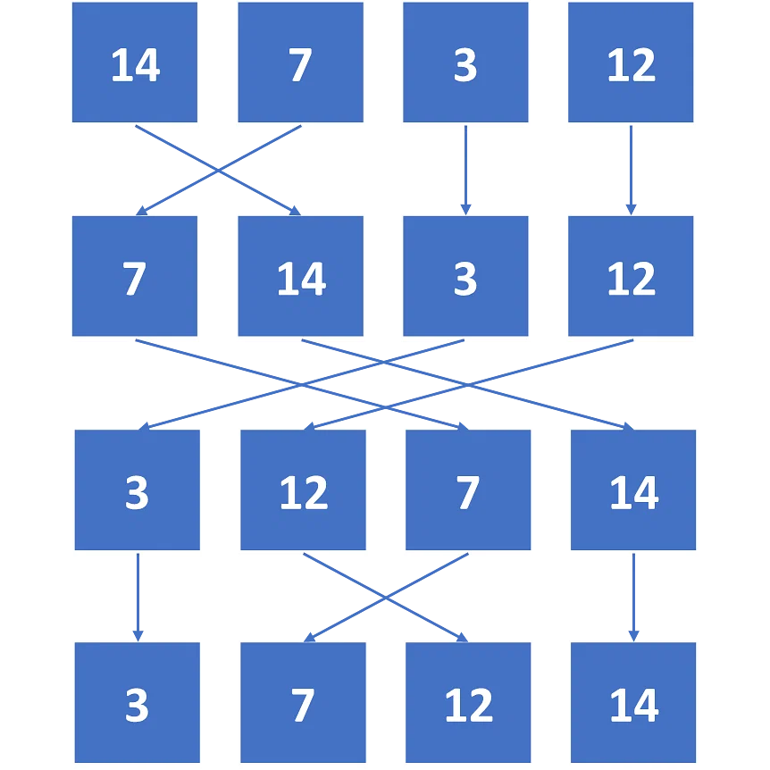

Slide 9

Questions?
Notes:
목차
자바의 생성배경
자바를 사용하는 이유
과거, 현재, 미래의 자바
자바의 발전과정
버전별 JDK에 대한 설명
자바와 C++의 차이점
자바의 성능
자바 관련 산업(?)의 경향

